Slide 1
MINI PROJECT FIRST REVIEW PRESENTATION STYLE
BuzzFeed

Slide 2
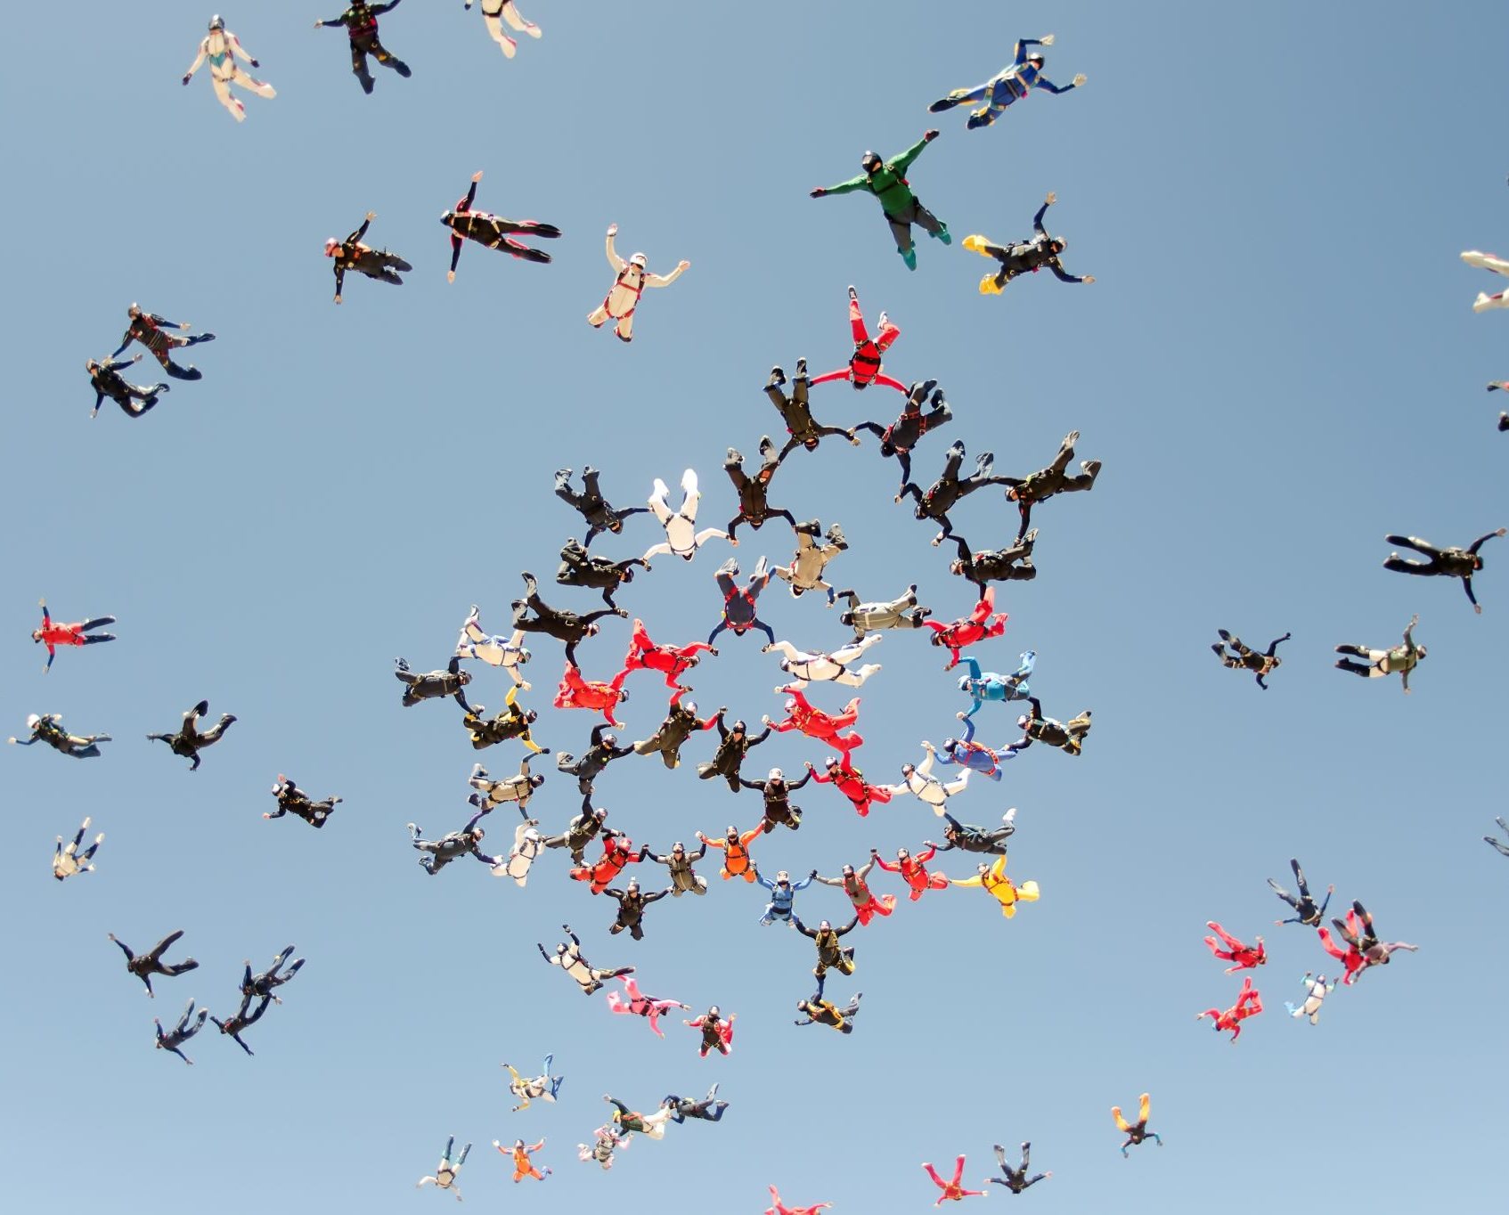
BuzzFeed
Supervisor : K. Srinivas
Batch no-31
Siddartha - 245318733107
Abhishek - 245318733121
Aadithya - 245318733061
Spandana - 245318733117

Slide 3

Contents:
Introduction
Abstract
Importance and need of your project Design
Tools and Technologies Implementation
System/User requirements Contributions
System Design
Conclusion of the Project

Slide 4
Abstract
Our project is a social networking site where
One can register
Registered user can maintain personal space
Search other peers.
Send friend requests.
Have conversations.
post videos, photos of fun content
Like and comment on feed

Slide 5

Introduction
When used properly, social media can be a valuable addition.
we ourselves saw the boon of social media amid pandemic.
our project is developed such that people can register and a registered user can maintain his/her own profile , post status and like feed.
A registered user can send friend requests over the site and receive notifications too.

Slide 6
Importance and need of your project
Social networking gives you a chance to connect with people around the world.
This technology gives us access to easy, instant communication tools.
Social networking creates brand exposure for businesses.
General fun and enjoyment
Awareness and Activism
Exchange of ideas and Collaboration

Slide 7
Tools and Technologies
Front-end: CSS,Bootstrap
Back-end: PHP
Database: MySQL
Server: Xampp

Slide 8
why?
Why PHP?
- ported by many hosting services , works quite well with a MySQL database
-The experience is significantly quicker and also more simple
-The deployment of applications and frameworks is quite simple.

Slide 9
Developer’s System requirements
For Development :
Any OS
Xampp
Visual Studio Code
Search engine
1GB RAM ,5GB free disk space

Slide 10
System Requirements for users
Any OS
Any web browser
stable internet connection

Slide 11
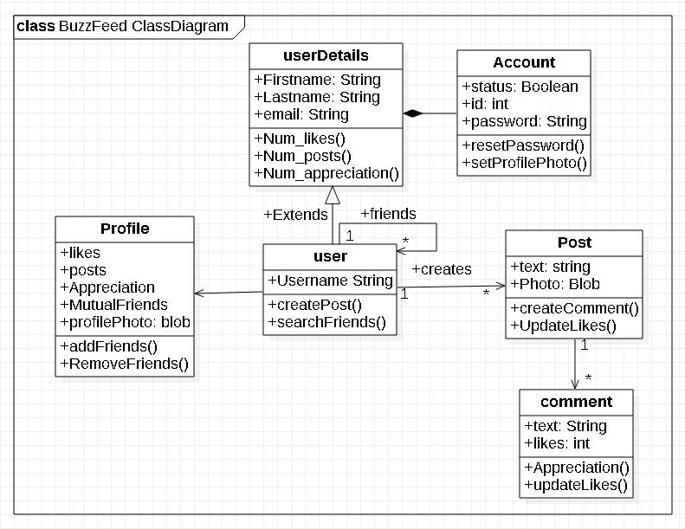
Class diagram
Class diagrams describe the static structure of a system, or how it is structured rather than how it behaves. These diagrams contain the following elements:
1.Classes,which represent entities with common characteristics or features. These features include attributes, operations and associations.
2.Associations,which represent relationships that relate two or more other classes where the relationships have common characteristics or features. These features include attributes and operations.

Slide 12
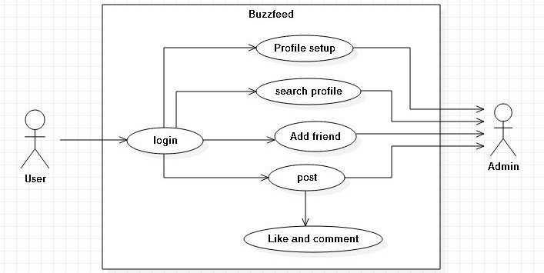
Buzzfeed Use case diagram
A use case diagram is a graphic depiction of the interactions among the elements of a system. A use case is a methodology used in system analysis to identify, clarify, and organize system requirements .In this context, the term “system” refers to something being developed or operated , such as a mail-order product sales and service website.

Slide 13
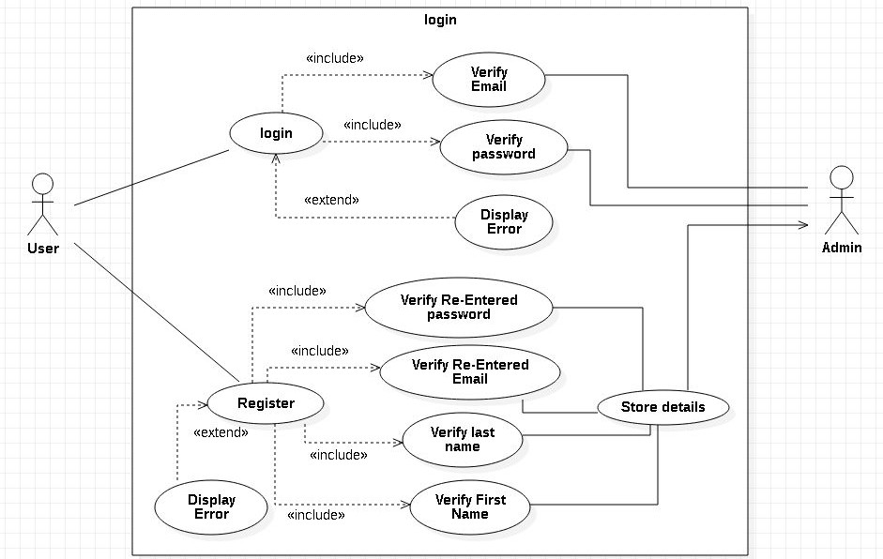
login Use Case Diagram
Use case diagrams are employed in UML, a standard notation for the modeling of real world objects and systems.
● The actors, usually individuals involved with the system defined according to their roles.
● The use cases, which are the specific roles played by the actors within and around the system, the relationships between and among the actors and the use cases.

Slide 14
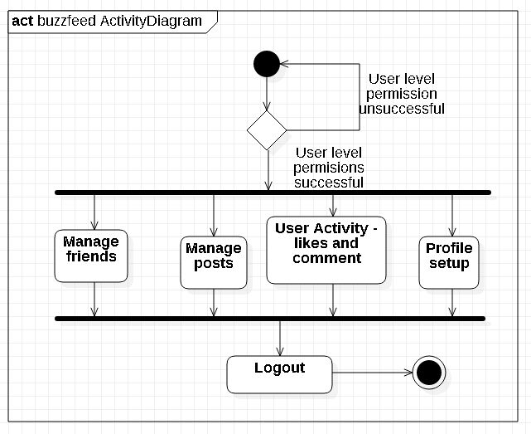
BuzzFeed Activity Diagram
An activity diagram visually presents a series of actions or flow of control in a system similar to a flowchart or a data flow diagram. Activity diagrams are often used in business process modeling. They can also describe the steps in a use case diagram . Activities modeled can be sequential and concurrent.

Slide 15
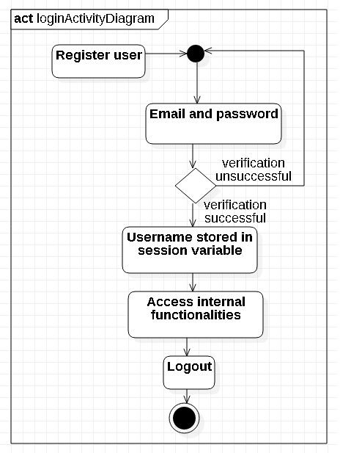
Activity Diagram

Slide 16
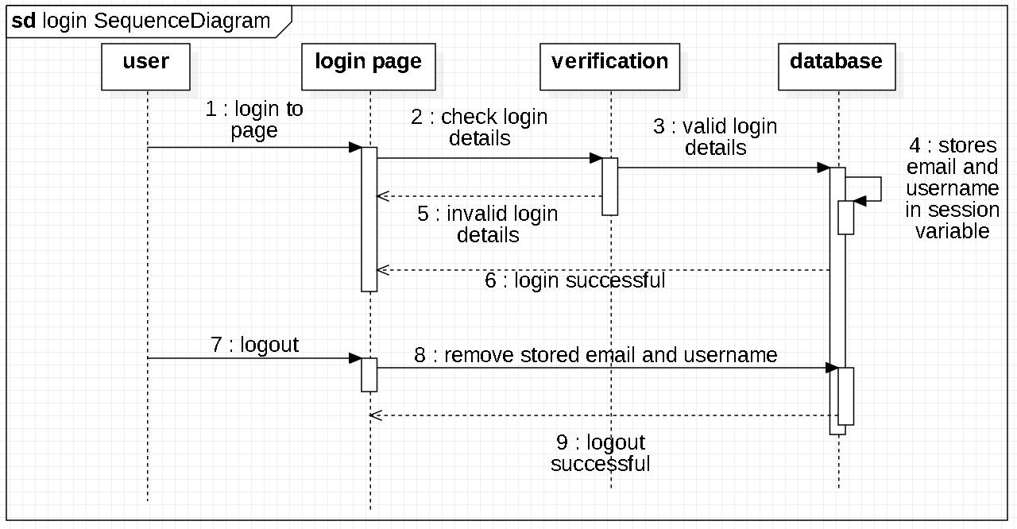
Login Sequence diagram
UML Sequence Diagrams are interaction diagrams that detail how operations are carried out. They capture the interaction between objects in the context of a collaboration. Sequence Diagrams are time focused and they show the order of the interaction visually by using the vertical axis of the diagram to represent time, what messages are sent and when.

Slide 17
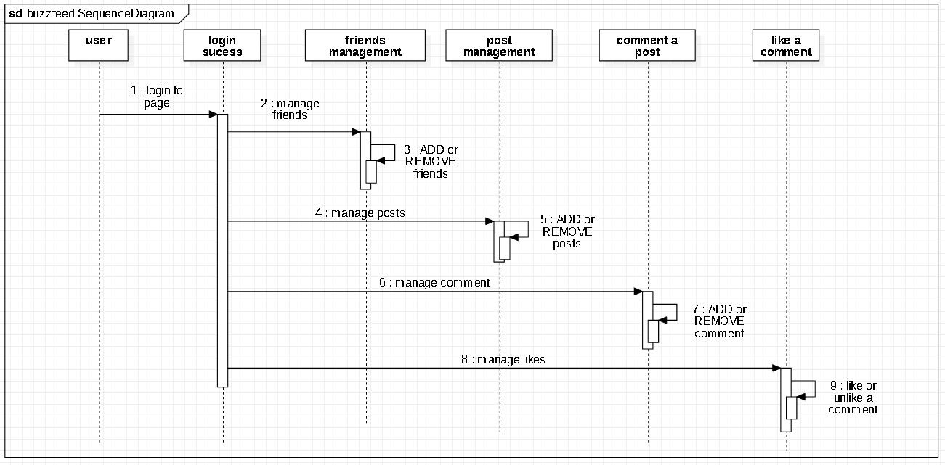
Buzzfeed Sequence diagram

Slide 18
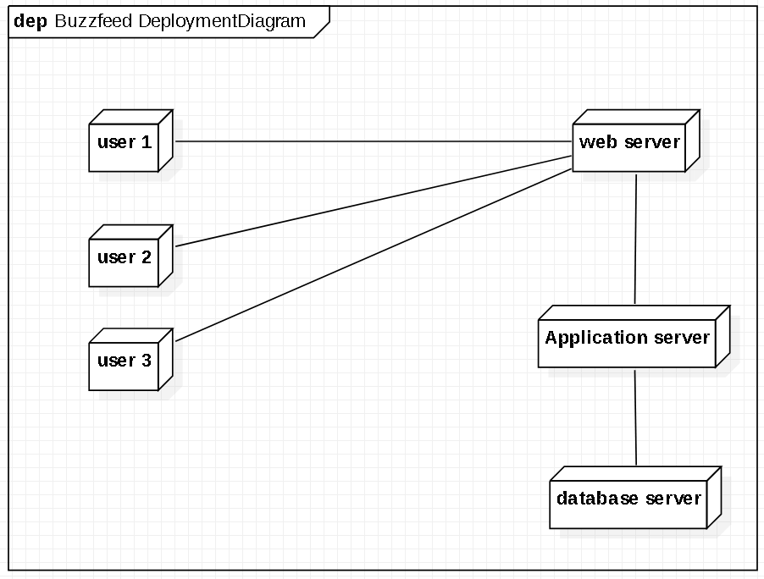
Deployment diagram
Deployment diagram shows the configuration of run-time processing nodes and the components that live on them. These diagrams address the static deployment view of architecture. Deployment Diagram displays the configuration of run-time processing elements and the software components, processes and objects that live on them. Software component instances represent run-time manifestations of code.

Slide 19
Further Implementations
Messaging
Receiving Notifications
Friend Suggestions
Search Friends

Slide 20
Conclusion of the Project
Social Networking website is a revolutionary idea with a very bright future with further scope for advancements.
The opportunities provided from this medium are immense and many organisations are making use of this medium to better their practices.
Organisations are no longer at the mercy of the media to advertise or convey their message.
With the help of social networking they can advertise or communicate in a more efficient way

Slide 21
THANK YOU

